Slide 1
PROJECT REPORT ON PUBLIC TRANSPORTATION EFFICIENCY ANALYSIS SUBMITTED BY B.LAVANYA PERI INSTITUTE OF TECHNOLOGY MANNIVKKAM

Slide 2
METHODOLOGY
In this study, the focus is on bus transportation since it is more flexible compared to rail transportation and widely preferred by the masses in cities. The primary data source of this study comes from the Department of Transportation for the City of Antalya.
We load the complete boarding data of December 18,2019 which is a standard weekday.
The boarding data consists of passenger Id, passenger’s boarding stop Id (origin), boarding time, bus Id, route Id (the direction on a particular line) .
For a particular route, bus stop locations with GPS coordinates required to visualize path on a map, are available from both municipal and commercial websites (such as www.ulasimburada.com).
The data set formed consist of 305 lines and 608 routes. A route consist of a sequential list of bus stops in either forward or backward (return) directions.
Each line has opposite two directions except two lines which are omitted in analysis. On December 18, 2019, a total of 7347 trips (single direction services) were made and with these trips a total of 381962 passengers were carried.
Efficiency of a transportation system as a whole requires individual busses which are limited in numbers run as efficient as possible while keeping residents happy through easy access to a bus service, quick access to destination, connectivity to 4 Kamer Ozg¨un and et.al ¨ transit network and comfort.
Our approach in improving transportation system has 2 stages; 1- improve route efficiency, 2- improve customer satisfaction. However, in this study we solely focus on the route efficiency. In a followup study we aim to include customer satisfaction aspect of the transportation

Slide 3
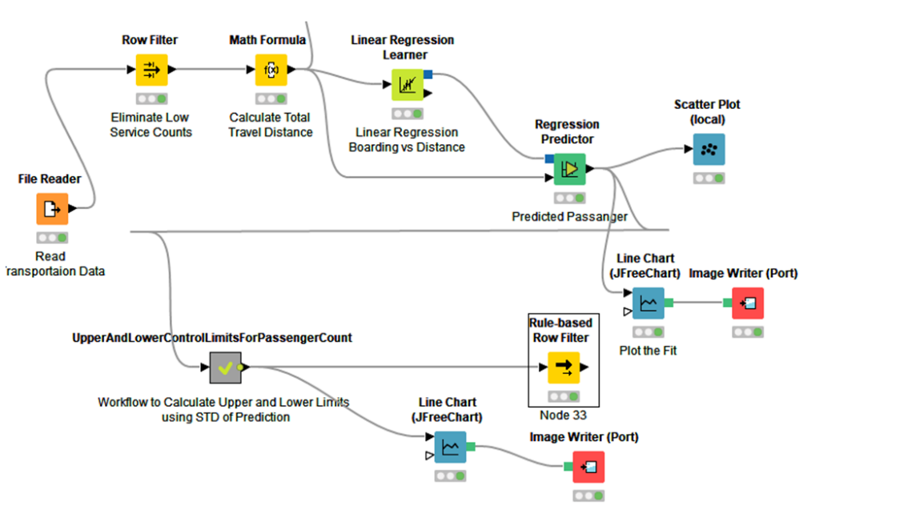
ASPECT OF TRANPORTATION

Slide 4
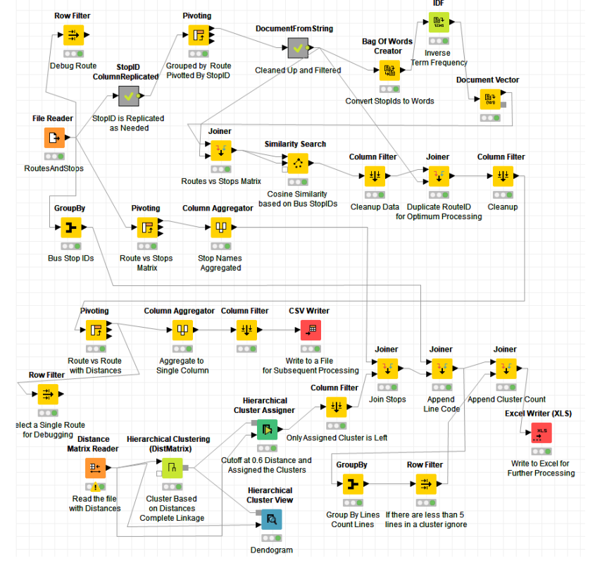
Analysis of Public Transportation for Efficiency

Slide 5
Hierarchical Clustering for Bus Stop Similarity
If routes and bus stops had to be eliminated or redesigned.
Then it is important to know which routes are close in terms of trip. Bus stops of a route may be used to determine overlapping routes.
Several similarity measures are available to determine close routes. Among them cosine similarity with inverse term frequency has advantages over others as it favors less frequent matches over frequent ones .
Cosine similarity based distance matrix is formed where Rows and Columns are Routes and each cell in the matrix has a value between 0 and 1 that represents the cosine angle between the two routes.
A distance value 0 means perfect match, whereas a distance matrix of 1.0 means routes do not have anything in common.
During the hierarchical clustering complete linkage method is used to calculate the cluster distances Once distance matrix is formed for routes, it has been used to cluster routes with respect to each other via distances calculated in the prior step.

Slide 6
Time-Location Variance Analysis of Route Boarding
Time-Location mapping of route boarding provides us to analyze the variation of boarding in both time domain and as well as route bus stop sequences.
Mapping involves counting boarding in subsequent bus stops for each trip on a route. Such mapping may be visualized using heatmap plot.
Visually, we can conclude that Route KC06 has the lowest variation both in time and location which is also consistent with the route efficiency of this route. Route LF10 has medium performance but Route CV 39 has the most variation both in location and trip.
Variance-Area curve obtained by Equation 4 allows us to quantify variation in both time and bus stop dimensions. Such numeric evaluation shown in Figure matches visual experience shown in Figure 6. CV 39 has the highest and KC06 has the lowest variation

Slide 7
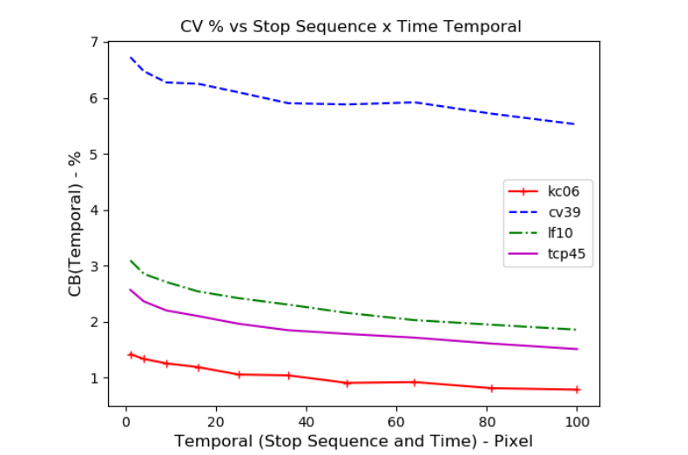
Bus Stop Analysis
For the selected date, there were 3140 distinct bus stops and among which 2804 has boarding data (at least 1 boarding). Among them infrequent bus stops are listed in Table . One can conclude from the table that there are 567 ( % 18)

Slide 8
Variance-Area Curves for Route Boarding
Simply put, the between-area variance curves are obtained by calculating the variances of gray scale pixel values while varying rectangular unit areas within the 2-D gray scale matrix.
This 2-D gray scale matrix is constructed from the heatmap image.
Although there are many ways to choose rectangular unit areas having equal area sizes , for the purpose of this study, these unit areas are considered squares.
Let m be the pixel length and n be the pixel width of the entire heatmap matrix.
The image is first partitioned into unit areas of size A1x1. The between-area variance curve, CB(Ak), is the plot of the coefficients of variation between the varying unit areas Ak×k. Mathematically, this relationship is formulated with Equation.
CB(Ak) = 100 F¯ k vuut 1 mknk Xmk i=1 Xnk j=1 [Fi,j − F¯ k] 2

